Slide 1

Analysis of Factors Influencing Fine Dust
By SeonYoung Jhang

Slide 2

Project Context
What is Fine Dust? Fine dust is particulate matter that can be found in the air that is incredibly small – containing air pollutants such as sulfur dioxide, nitrogen oxides, lead, ozone, carbon monoxide, etc. These pollutants are emitted from sources like automobiles, factories, and cooking processes, and consist of fine particles with a diameter of 10 ㎛ or less, which can linger in the air for an extended period
The Impact of Fine Dust on Our Lives: - Health Prolonged exposure to fine dust can adversely affect human health. - Environment When fine dust accumulates in vinyl greenhouses, it can lead to reduced sunlight and disruption of photosynthesis in crops, contributing to soil degradation - Economy Economic losses occur due to the negative impact of fine dust, causing economic downturns and affecting industries sensitive to fine dust, such as semiconductors and displays. (estimated economic losses amount to approximately KRW 4.23 trillion annually – Hyundai Economic Research Institute)
Notes:
2

Slide 3
Project Context
In the Ministry of Environment’s report on domestic environmental trends, the causes of fine dust are analyzed as follows: 1) Domestic Factors The proportion of domestically generated fine dust is 50-70% : 51% of fine dust in Seoul being domestically produced. : 68.2% are particles released through the combustion of fossil fuels. 2) International Factors Approximately 43% of domestic fine dust is attributed to factors such as emissions from factories and vehicle exhaust in China, as well as desert dust.
Other related Information 1) Direction of the Wind When winds from the west blow, the concentration of fine dust is high 2) Speed of the Wind In the wind speed range of 0-6 m/s, the highest concentration occurs during calm conditions and the concentration decreases as wind speed increases. Beyond 6 m/s, the concentration increases with the rising wind speed. 3) Weather On days with yellow dust or foggy weather, the concentration of fine dust tends to be high 4) Humidity When the humidity is between 60% and 90%, the fine dust concentration is elevated. High humidity promotes the formation of secondary particulate matter in the atmosphere, such as sulfuric and nitric acid salts.
Weather Variable
Domestic Factors
Atmospheric
Variable
International
Factors
Notes:
3

Slide 4
Project Objective
The background information indicated that various factors influence the concentration of fine dust.
Therefore, there is a need to verify whether the given fine dust-related data aligns with these background information based on the understanding the fine dust.
Given the multifaceted negative impacts of fine dust, the goal is to better identify factors influencing fine dust and to develop a prediction model of its occurrence amount

Slide 5
Project Process
1. Data Collection
3. EDA
Data Visualization
4. Analysis
Correlation
2-Sample t-test
5. Modelling
Multiple Regression
Decision Tree
Random Forest
Gradient Boosting
7. Conclusion
2. Data Quality
Null Values
Outliers
Derived Variables
6. Model Evaluation

Slide 6
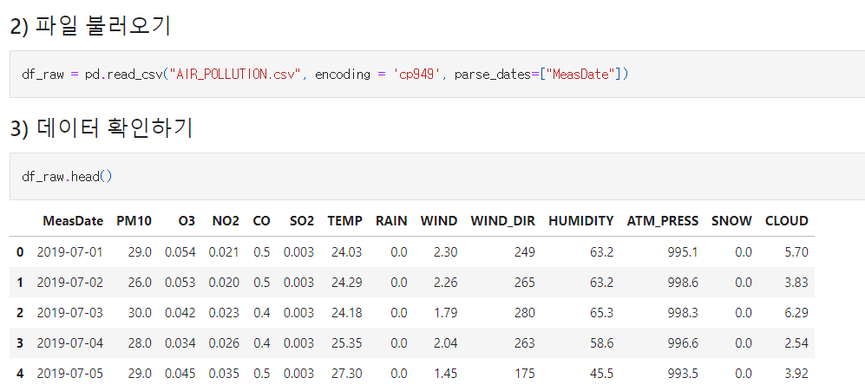
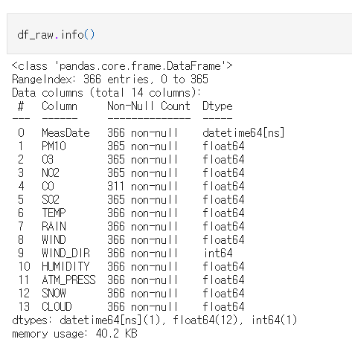
Data Collection
Jul 1st, 2019 ~ June 30th, 2020
Target Variable: PM10
Independent Variable: O3, NO2, CO, SO2, TEMP, RAIN, WIND, WIND_DIR, HUMIDITY, ATM_PRESS, SNOW, CLOUD
Notes:
PM10 CO 계절 HUMIDITY TEMP ATM_PRESS WINDDIR SO2

Slide 7
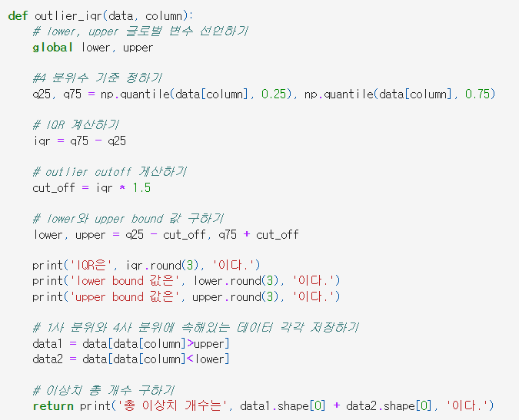
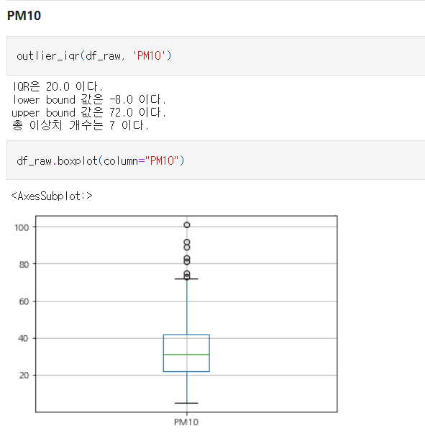
Data Cleansing
Null Values
Outliers
Using user-defined function
Detecting outliers for each variable
However, no separate handling for outliers is done
Variable | # of Null
PM10 | 1
O3 | 1
NO2 | 55
CO | 1
SO2 | 1
- Multiple missing values were identified in 2020-05-02
→ Removal
- For NO2, input the average value by season
Notes:
PM10 CO 계절 HUMIDITY TEMP ATM_PRESS WINDDIR SO2

Slide 8
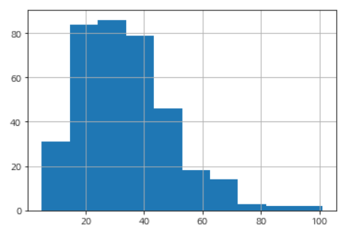
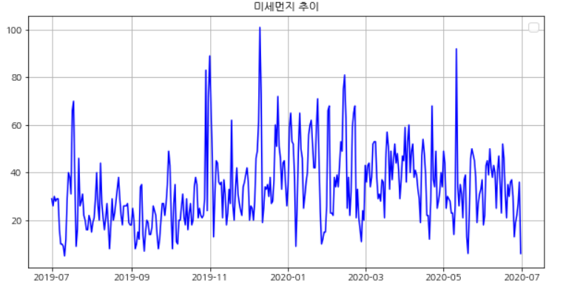
Data Visualization
1) Target Variable (PM10)
Checking the distribution through a Histogram
Verifying the trend of fine dust over time using a Line Graph.
Notes:
PM10 CO 계절 HUMIDITY TEMP ATM_PRESS WINDDIR SO2

Slide 9
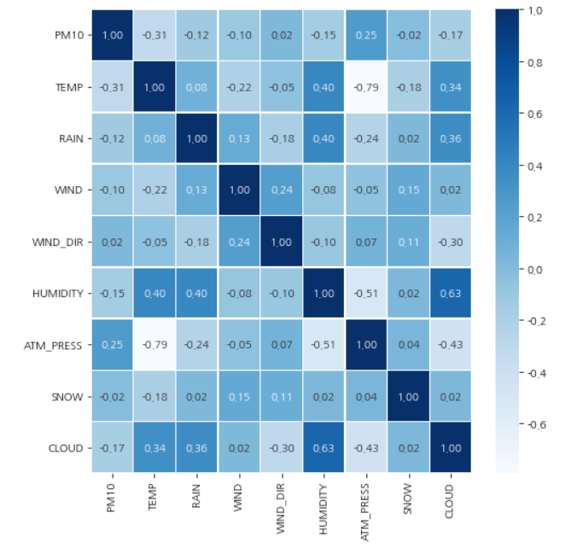
Data Visualization
2) Independent Variables
The given X variables were grouped based on two main criteria
1) Weather Variable : TEMP, RAIN, WIND, WIND_DIR, HUMIDITY, ATM_PRESS, SNOW, CLOUD
→ There is no significant correlation with PM10
Notes:
PM10 CO 계절 HUMIDITY TEMP ATM_PRESS WINDDIR SO2

Slide 10
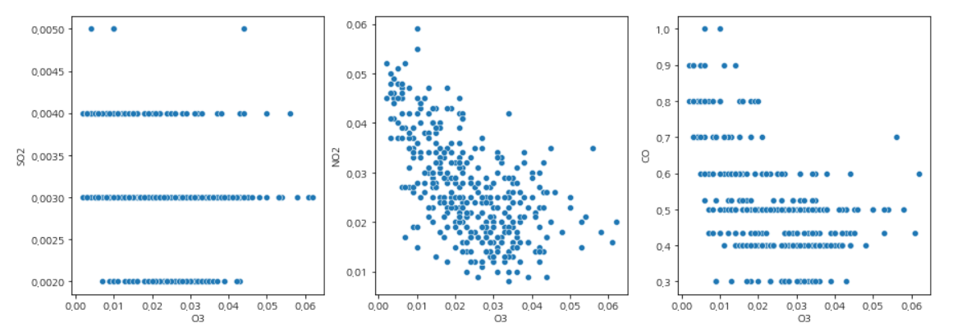
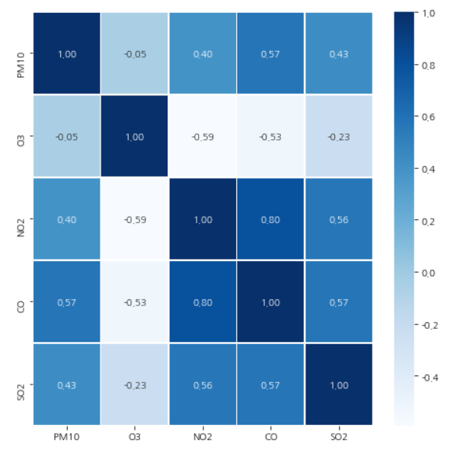
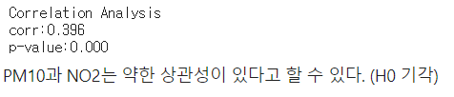



Data Visualization
2) Independent Variables
The given X variables were grouped based on two main criteria
2) Atmospheric Variable : O3, NO2, CO, SO2
→ O3: Not directly influenced by PM10.
BUT, shows a negative correlation with SO2, NO2, and CO as observed in the scatter plots.
In other words, while O3 may not have a direct impact, but it is indirectly associated
<Correlation Analysis>
PM10과 NO2/CO/SO2
< Correlation Analysis >
PM10과 O3
→ There is a correlation between PM10 and NO2, CO, and SO2.
Notes:
PM10 CO 계절 HUMIDITY TEMP ATM_PRESS WINDDIR SO2

Slide 11
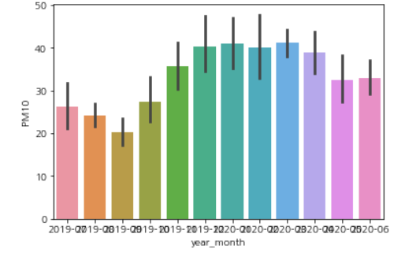
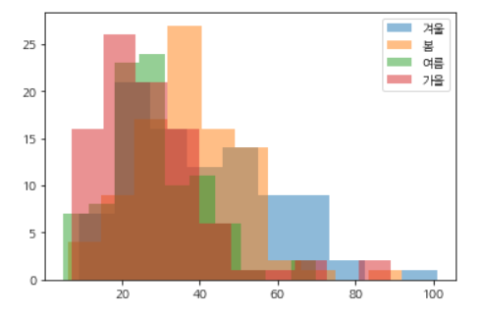
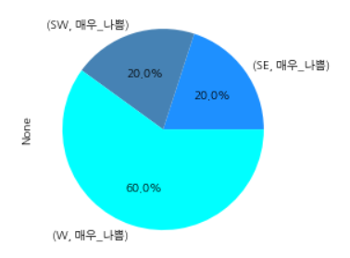
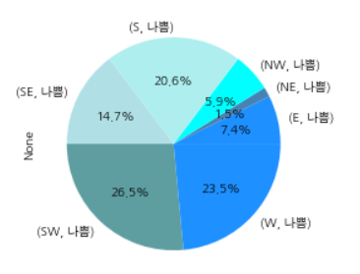
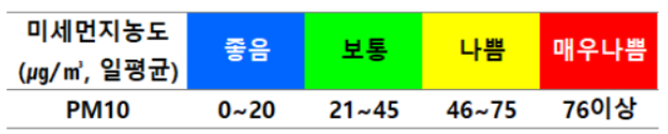
Data Visualization
3) Derived Variables
1) Seasons
- PM10
: Categorized according to WHO standards into Good/Normal/Bad/Very Bad
- WIND_DIR
: Detailed categorization of wind direction into 8 compass directions.
- WIND : Detailed categorization based on wind speed.
- Seasons
- Rain/Snow
→ PM10 exhibiting varying trends across different seasons
→ Particularly high levels of PM10 are observed during the winter.
2) Wind Direction
<Reference>
WHO Standard
In cases where PM10 is categorized as 'Very Bad' or 'Bad', W (west) and SW (southwest) directions account for more than 50%.
Notes:
PM10 CO 계절 HUMIDITY TEMP ATM_PRESS WINDDIR SO2

Slide 12
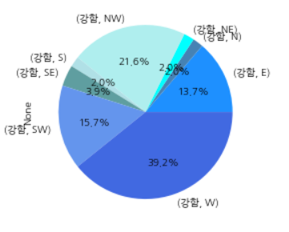
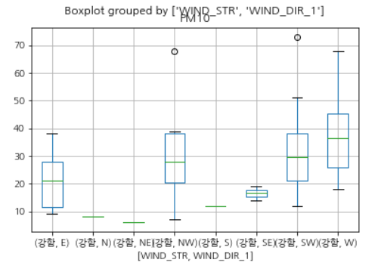
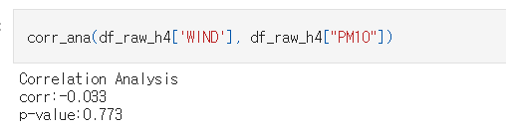
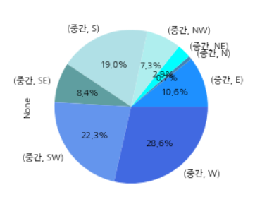
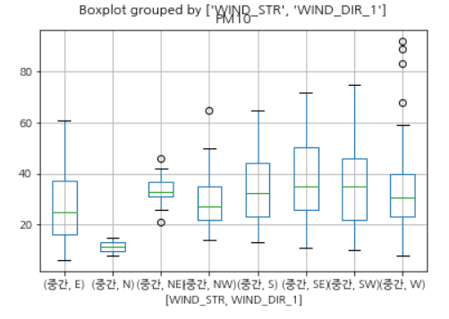
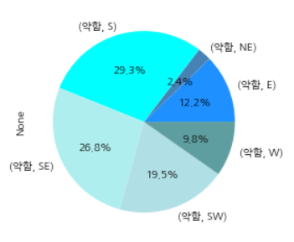
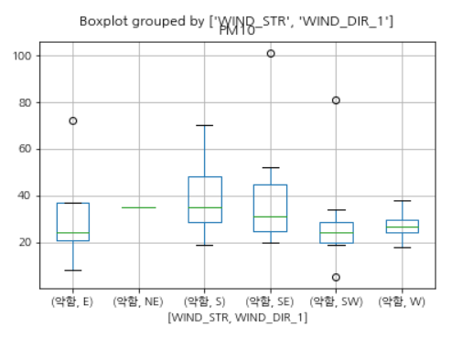
Data Visualization
3) Derived Variables
3) Wind Speed
[Hypothesis] If the wind speed is high and from the west, PM10 levels are expected to be high.
→ According to the correlation analysis, there is no correlation between wind speed and PM10.
BUT Referring to the Boxplot, it can be observed that when the wind speed is high/medium, and the wind direction is from the W (west) or SW (southwest), PM10 levels were high or exhibited outliers towards the higher values.
<Selection of Influential Factors for Prediction Model>
NO2 / CO / SO2 / Atmospheric Pressure / Temperature / Humidity / Season / Wind Direction / Wind Speed

Slide 13
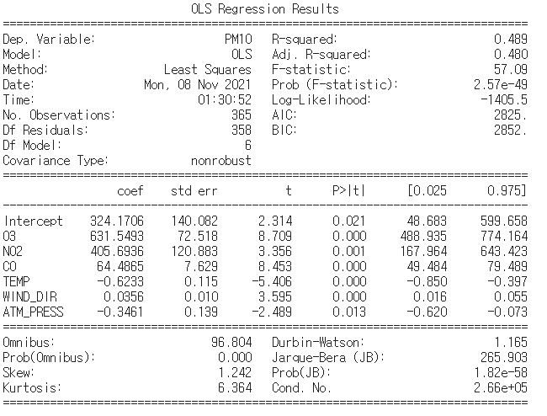

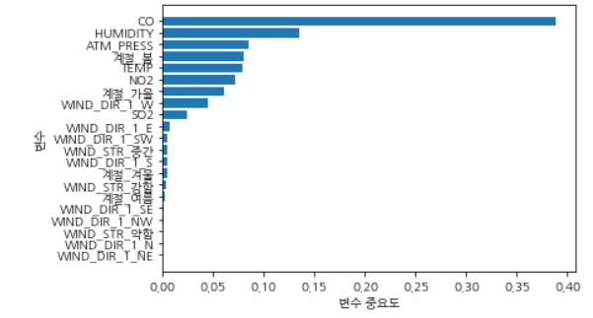
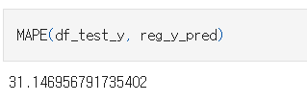


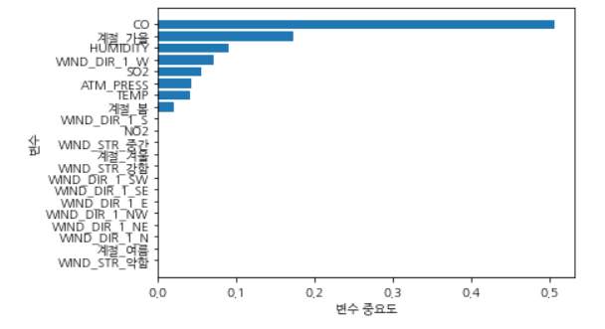
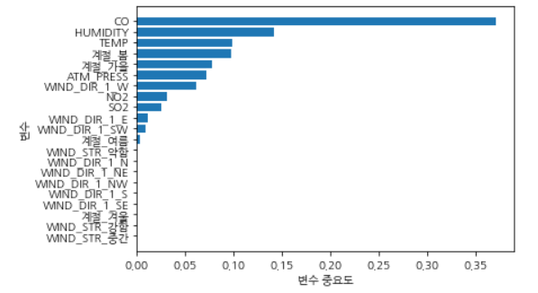
Prediction Model
Multiple Linear Regression
- R-squared: 48.6%의 설명력 - Prob(F-statistics): 2.57e-49 Statistically significant
Final Model Regression Equation
Y_hat = 324.1706 + 631.5493 O3 + 405.6936 NO2 + 64.4865 CO – 0.6233 TEMP – 0.3451 ATM_PRESS
Random Forest
N_estimator: 50
Leaf: 5
Split : 10
Max depth: 8
MAPE: 31.13
Judged as a highly reasonable prediction as it is below 50. (Tofallis, 2016)
Decision Tree
Gradient Boosting
Leaf : 10
Split : 22
Max depth: 4
N_estimator: 70
Leaf: 22
Max depth: 3
Learning rate: 0.1

Slide 14
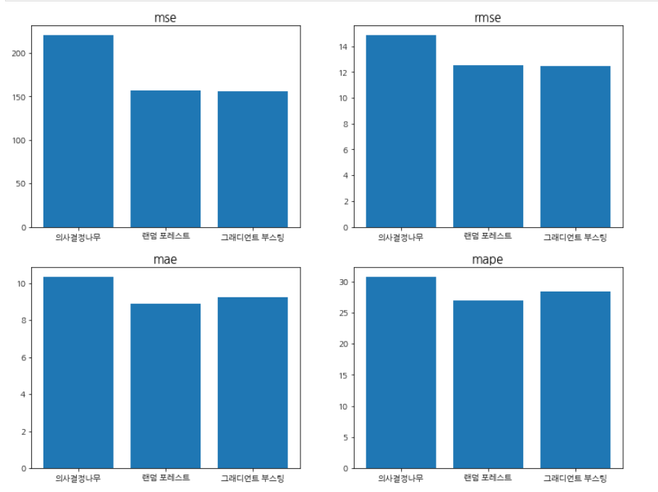
Conclusion
Analysis Result - PM10 levels have a weak correlation with weather-related variables and a strong correlation with atmospheric-related variables. - Seasons play a significant role in relation to PM10, especially showing high PM10 in winter. - Based on the 8-direction wind criteria, fine dust concentrations are particularly high in cases of west and southwest winds, categorized as 'Bad' or 'Very Bad'.
Prediction Model - Used Multiple Regression Analysis / Decision Tree / Random Forest / Gradient Boosting to devise the prediction model - Random Forest and Gradient Boosting showed comparatively high accuracy. - Shared Key Influential Variables : CO, HUMIDITY, ATM_PRESS, Season.
Notes:
PM10 CO 계절 HUMIDITY TEMP ATM_PRESS WINDDIR SO2

Slide 15
Appendix
# | Variable | Details | Type | Reason for excluding | EDA |  |  | Modelling
 |  |  |  |  | Graph | Statistic Analysis | Correlation Analysis | Regression | DT | RF | GB
1 | MeasDate | Date | Continuous | -
2 | PM10 | Particulate Matter 10㎍/㎥ | Continuous |  | line, histogram
3 | O3 | Ozone Concentration | Continuous | Indirect Influence | heatmap, box plot, scatterplot |  | O | O
4 | NO2 | Nitrogen Dioxide Concentration | Continuous |  | heatmap, box plot, scatterplot |  | O | O | O | O | O
5 | CO | Nitric Oxide Concentration | Continuous |  | heatmap, box plot, scatterplot |  | O | O | O | O | O
6 | SO2 | Sulfur Dioxide Concentration | Continuous |  | heatmap, box plot, scatterplot |  | O |  | O | O | O
7 | TEMP | Temperature (°C) | Continuous |  | heatmap |  | O | O | O | O | O
8 | RAIN | Precipitation (mm) | Continuous | Low Correlation | heatmap | 2 sample t-test
9 | WIND | Wind Speed (m/s) | Continuous | *Converted to Categorical | heatmap, box plot, pie chart |  | O |  | O | O | O
10 | WIND_DIR | Wind Direction (16Cardinal Directions) | Continuous | *Converted to Categorical | heatmap, box plot, pie chart |  | O | O | O | O | O
11 | HUMIDITY | Humidity(%) | Continuous |  | heatmap |  |  |  | O | O | O
12 | ATM_PRESS | Atmospheric Pressure(hPa) | Continuous | *Converted to Categorical | heatmap |  |  | O | O | O | O
13 | SNOW | Snowfall(cm) | Continuous | Low Correlation | heatmap | 2 sample t-test
14 | CLOUD | Cloud Cover (in tenths) | Continuous | Low Correlation | heatmap
15 | Season | Four Seasons | Discrete |  | heatmap, box plot, histogram, bar plot | 2 sample t-test | O |  | O | O | O
Notes:
PM10 CO 계절 HUMIDITY TEMP ATM_PRESS WINDDIR SO2

Slide 16
Thank You

